Slide 1
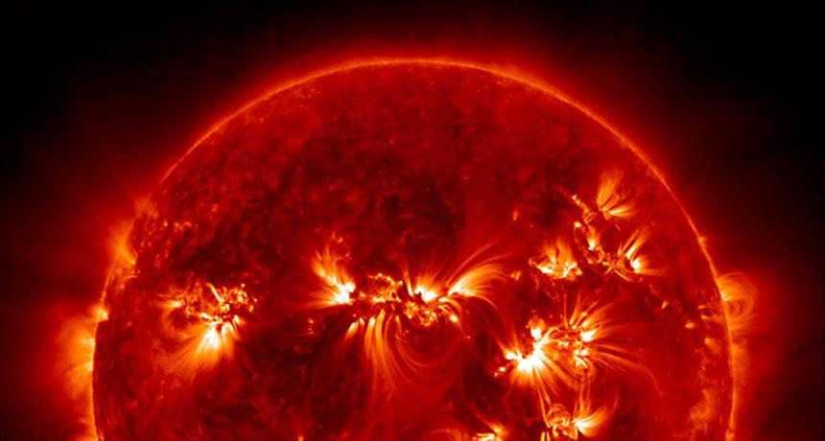
SOLAR ROTATION
ASTRONOMY 101: LAB 3

Slide 2
RUBRIC

Slide 3
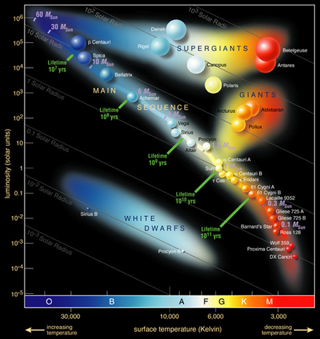
SUN FACTS
The sun is a G-Type star.
Surface temperature of roughly 5,778 degrees Kelvin.
About 1.4 million km in diameter (will use a more precise number in this lab)
Can fit over 1 million Earths.
Note: The Temperature Axis is Reversed

Slide 4
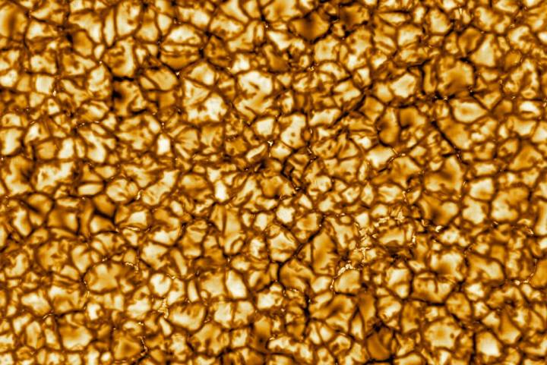
THE SUN IS NOT A SOLID BODY
The image shows the sun’s surface at the highest resolution ever taken, shot by the Daniel K. Inouye Solar Telescope (DKIST), the world’s largest solar telescope, on the island of Maui, Hawaii, U.S., January 29, 2020.

Slide 5
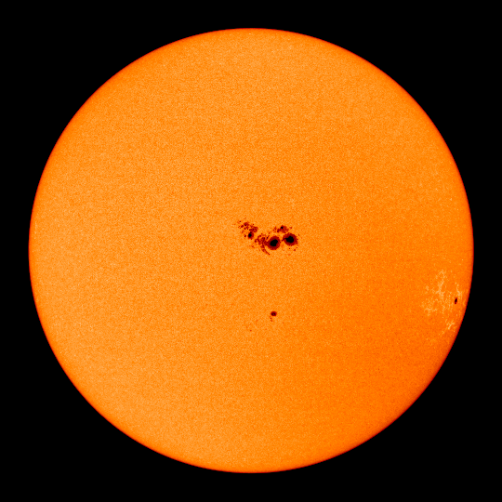
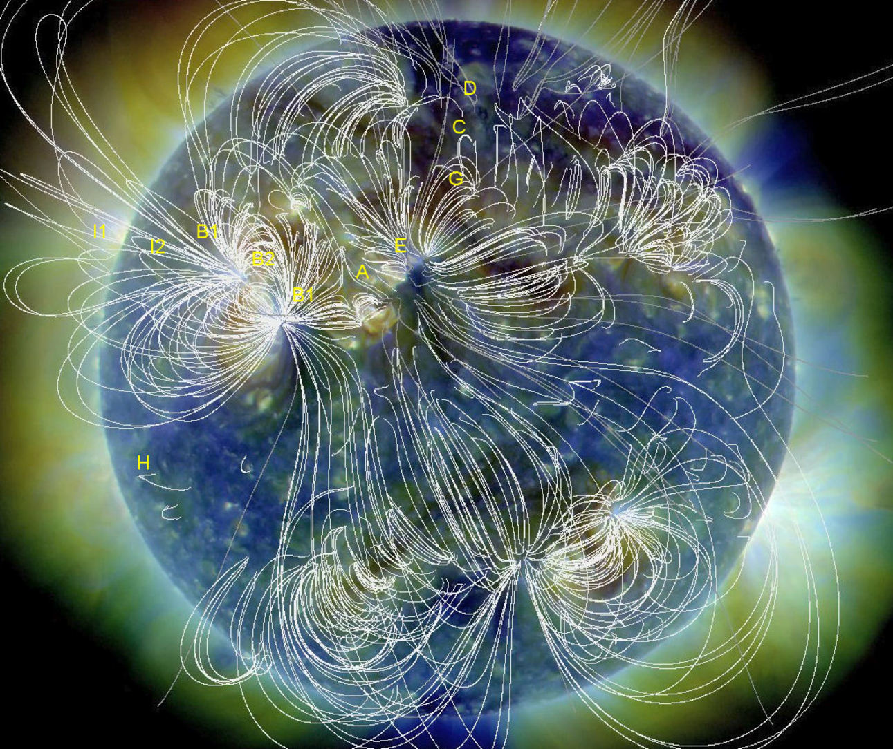
SUN SPOTS
Internal convection causes strong magnetic fields.
Concentration of magnetic field flux causes sun spots.
Sun spots are found on the photosphere.
Are at a lower temperature compared to the rest of the surface.
Shows that the “heavens” are not perfect, contrary to old Ptolemaic/Greek cosmology as taught by the church.

Slide 6
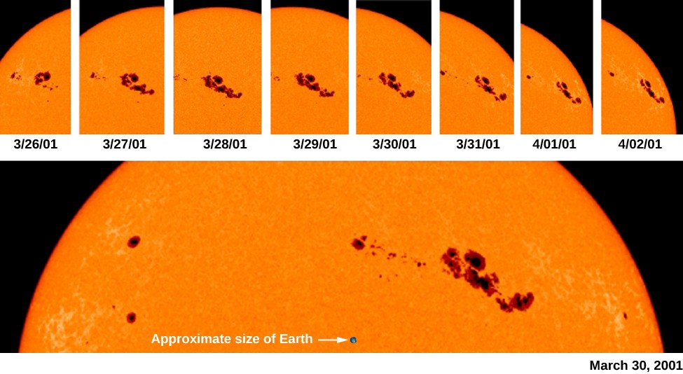
We can use sun spots to measure the rotational period of the sun

Slide 7
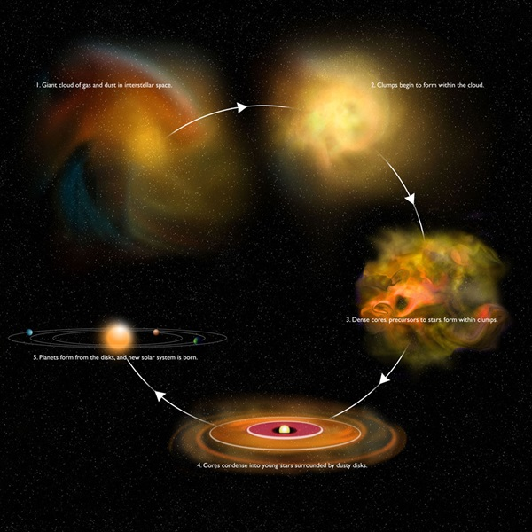
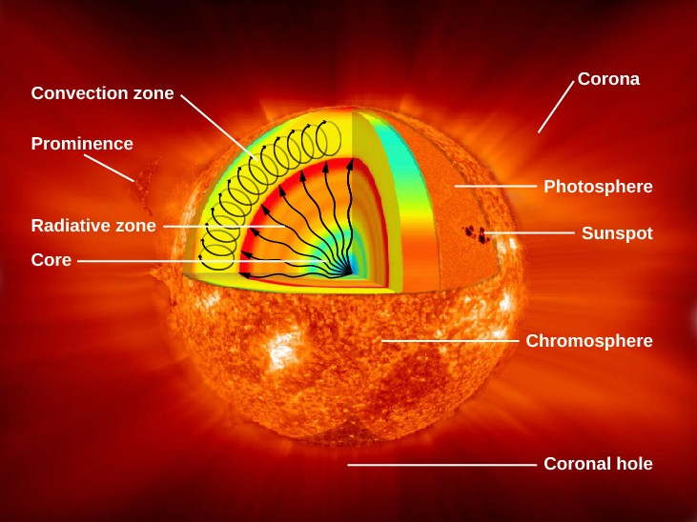
WHAT CAN THE SOLAR ROTATION TELL US?
The Sun’s formation history
The Sun’s internal dynamics

Slide 8
ASSUMPTIONS FOR THIS LAB
The sun is perfectly spherical.
Sun spots don’t change shape with time.
Sun spots will move at the same rate towards the edges of the sun as they do towards the middle (look up foreshortening).
How you decide to measure each sun spot.

Slide 9
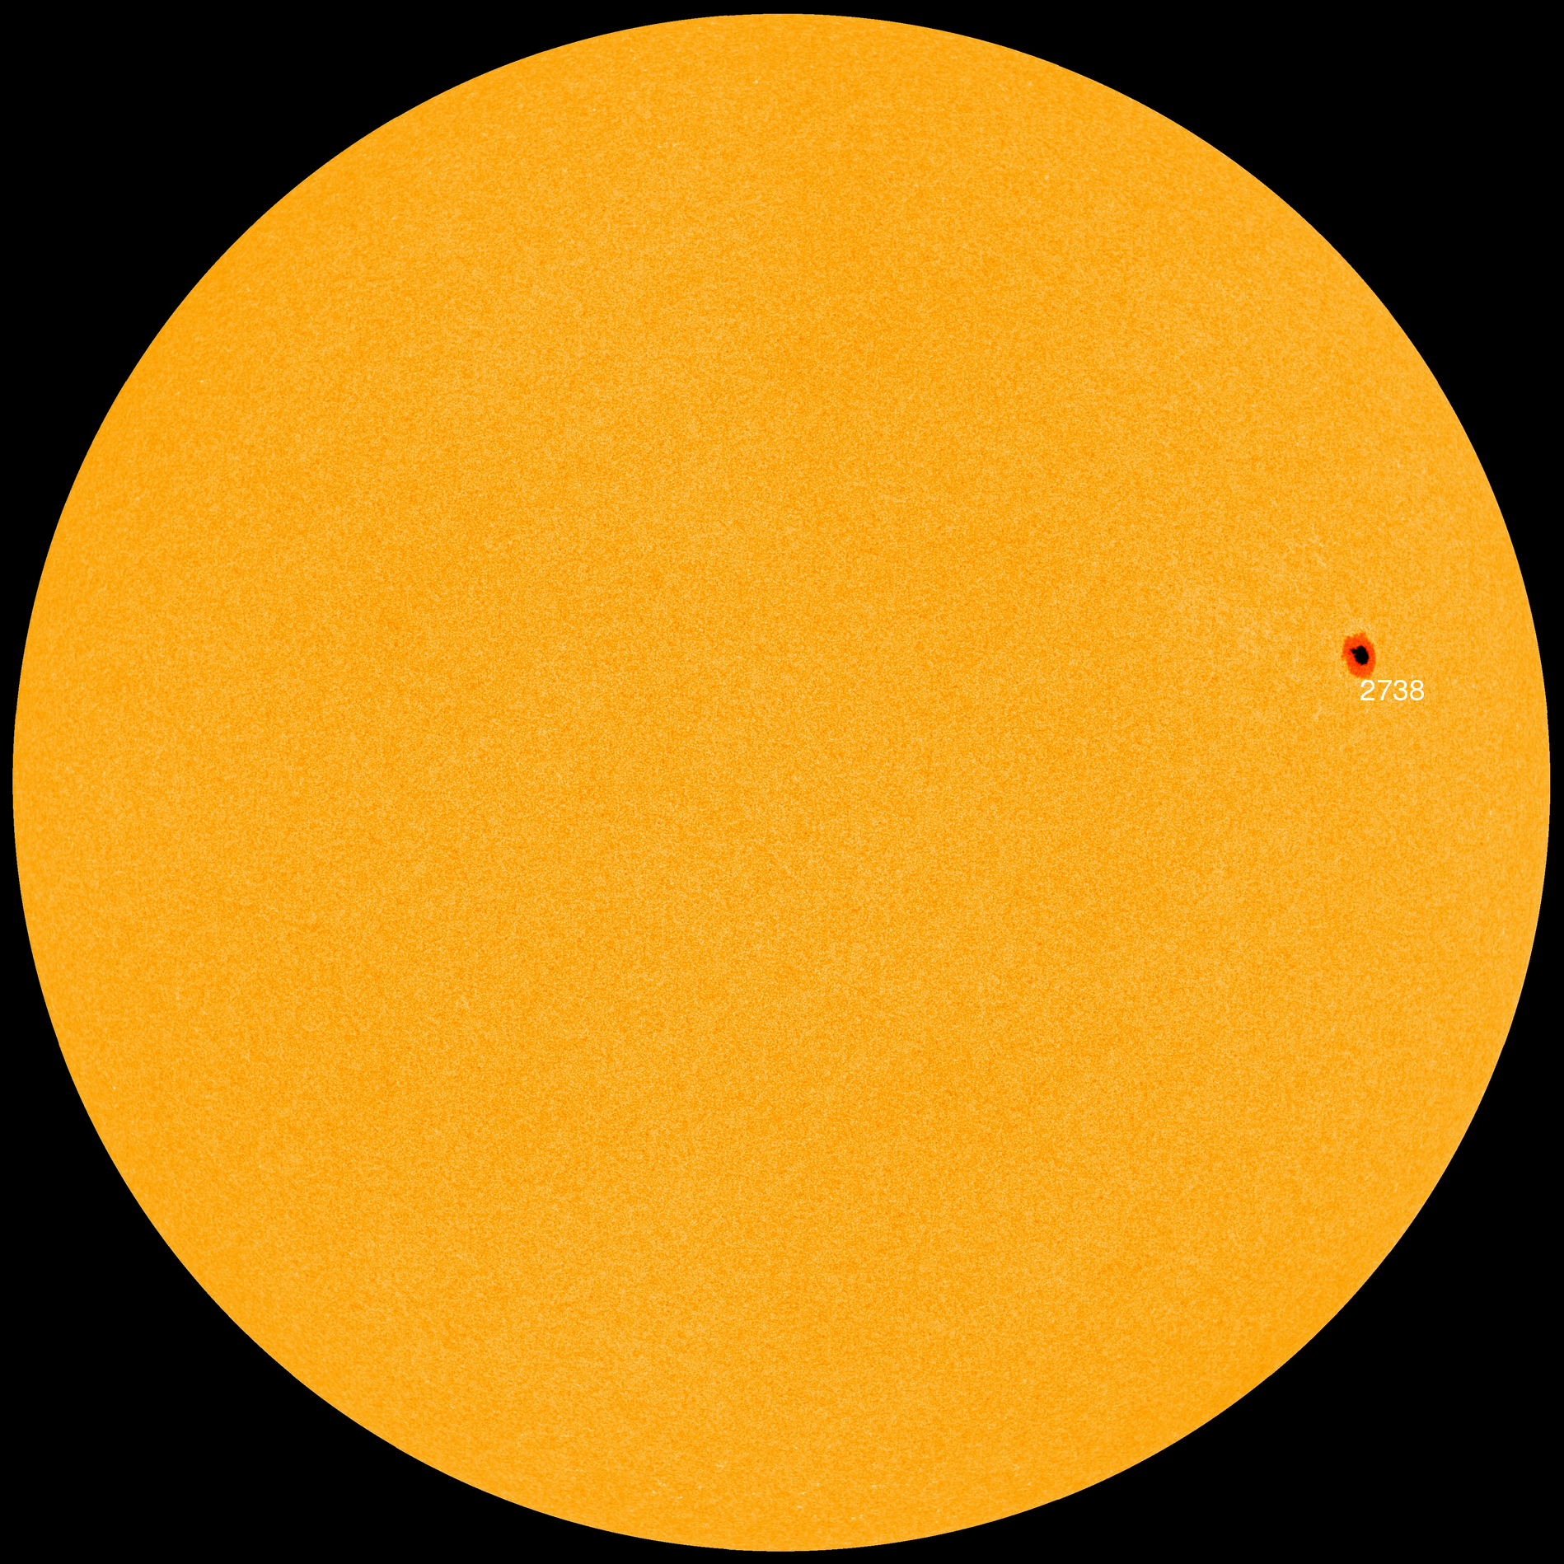

Slide 14



Slide 15
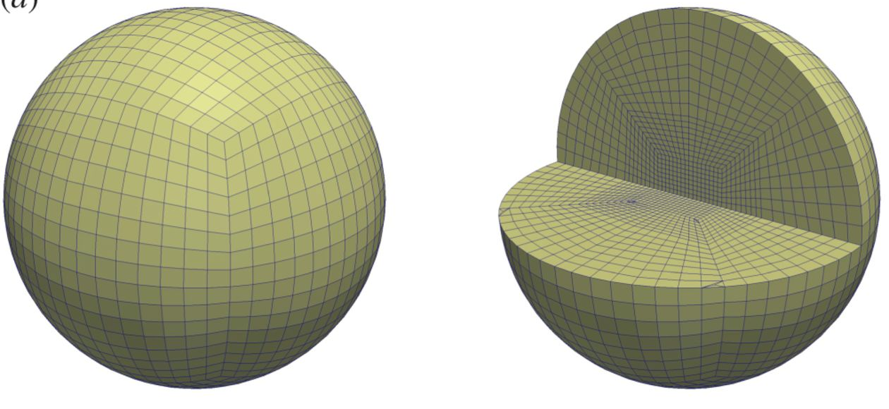
PROJECTION: SUN IS NOT 2D
Centre of Sun

Slide 16
INSTRUCTIONS CONT.
Calculate the rotational period: P = (360deg / Angle) x 1 day
Calculate the mean and uncertainty for the period: Order your measured periods from lowest to highest. Middle value will be your mean. Take 2nd to lowest period and subtract from 2nd to highest and divide by 2 . This is your uncertainty (AKA the Median and Interquartile Uncertainty)
Answer questions 1-5 (and include the discussion points!):
-Q1: Measure sunspot closest to the middle.
-Q5: Sidereal period = (360deg / ( Angle + 1deg)) x 1 day

